Slide 1
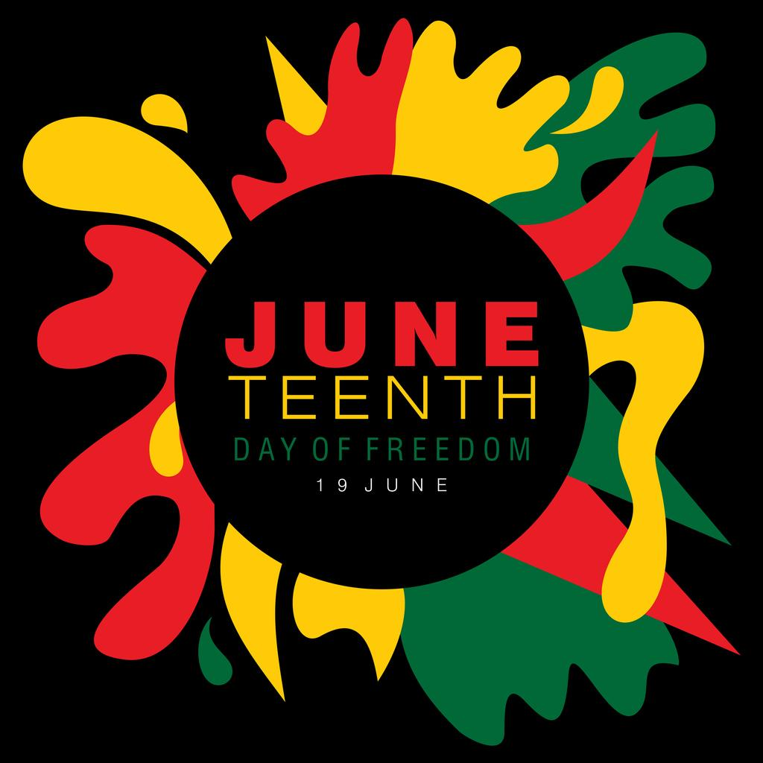
Introduction and Welcome
(4 min)
11:45am - 12:45 pm

Slide 2
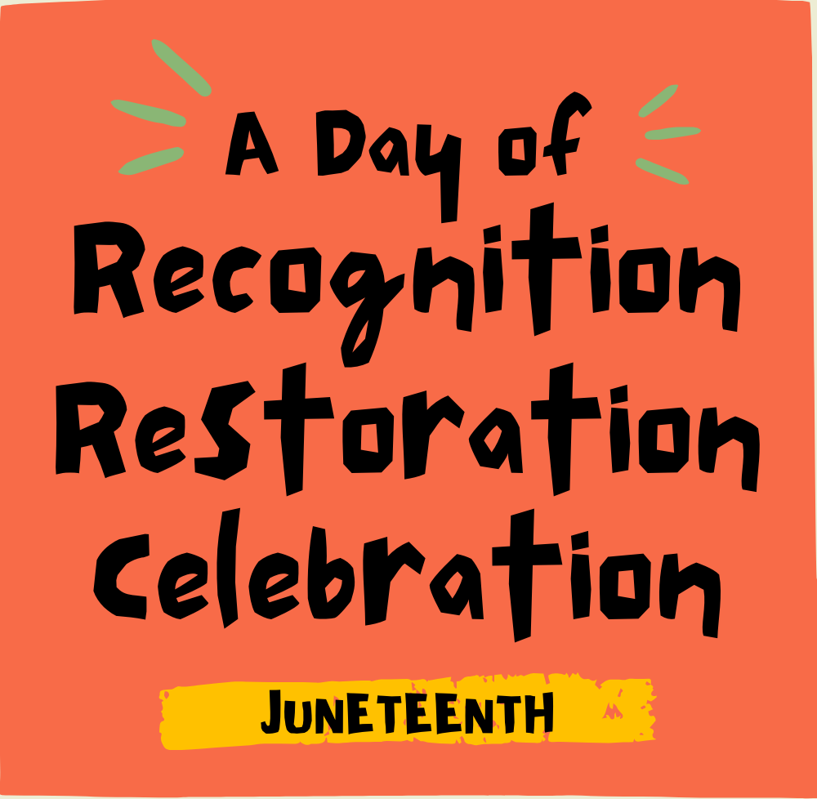

Slide 3
The Juneteenth Flag
Designed in 1997

Slide 5
Optional: take notes!
Self-evaluation
(2 min)

Slide 6
WHAT DO YOU ALREADY KNOW ABOUT JUNETEENTH?
(2 min self-evaluation in silence)
What event took place on June 19, 1865 in Galveston TX, which is the reason Juneteenth is observed?
Juneteenth became a federal holiday on June 17 of what year ?
Do you know the month and year of the Emancipation Proclamation? Who signed this executive order?
Since the Emancipation Proclamation had already been issued, what specifically did the 13th Amendment abolish on January 31, 1965? What is the exception written into the 13th amendment?
Why have certain African American foods been stigmatized?
Name at least one theme reflected in spiritual songs sung by enslaved people and their descendents?

Slide 7
HISTORY
(10 min)

Slide 8
Emancipation Proclamation
Background
1619 Jamestown - 20 captive Africans sold into slavery
1671 George Fox, Barbados, concern for enslaved
1776 PYM forbids members from holding slaves
1777 Vermont abolishes slavery
1788 US Constitution ratified with ⅗ Compromise
1788-1861 Balancing free/slave states

Slide 9
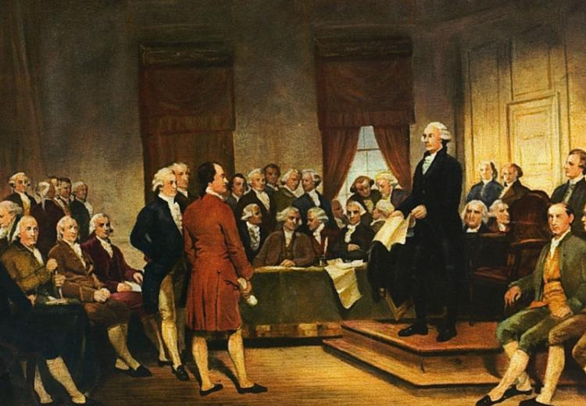
Three-fifths Compromise
Article I, Section 2 of the U.S. Constitution states:
“Representatives and direct Taxes shall be apportioned among the several States which may be included within this Union, according to their respective Numbers, which shall be determined by adding to the whole Number of free Persons, including those bound to Service for a Term of Years, and excluding Indians not taxed, three fifths of all other Persons.”

Slide 10
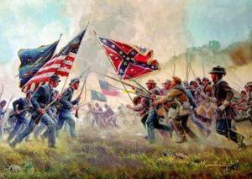
The Civil War 1861
Confederacy- slave states
Union - mostly free states
Border States (Maryland, Delaware, Kentucky, Missouri) - slave states
West Virginia, District of Columbia - slave, then free

Slide 11
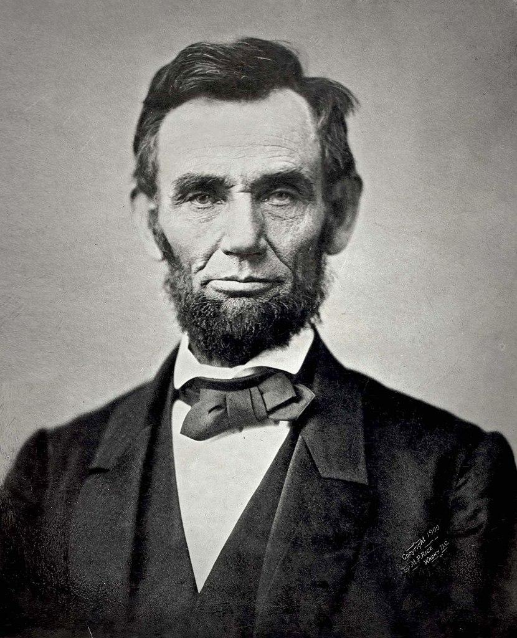
Emancipation Proclamation - September 22, 1862
That on the first day of January, in the year of our Lord one thousand eight hundred and sixty-three, all persons held as slaves within any State or designated part of a State, the people whereof shall then be in rebellion against the United States, shall be then, thenceforward, and forever free.

Slide 12
What were the causes of the Emancipation Proclamation?
Moral?
Political?
Economic?
Military?

Slide 13
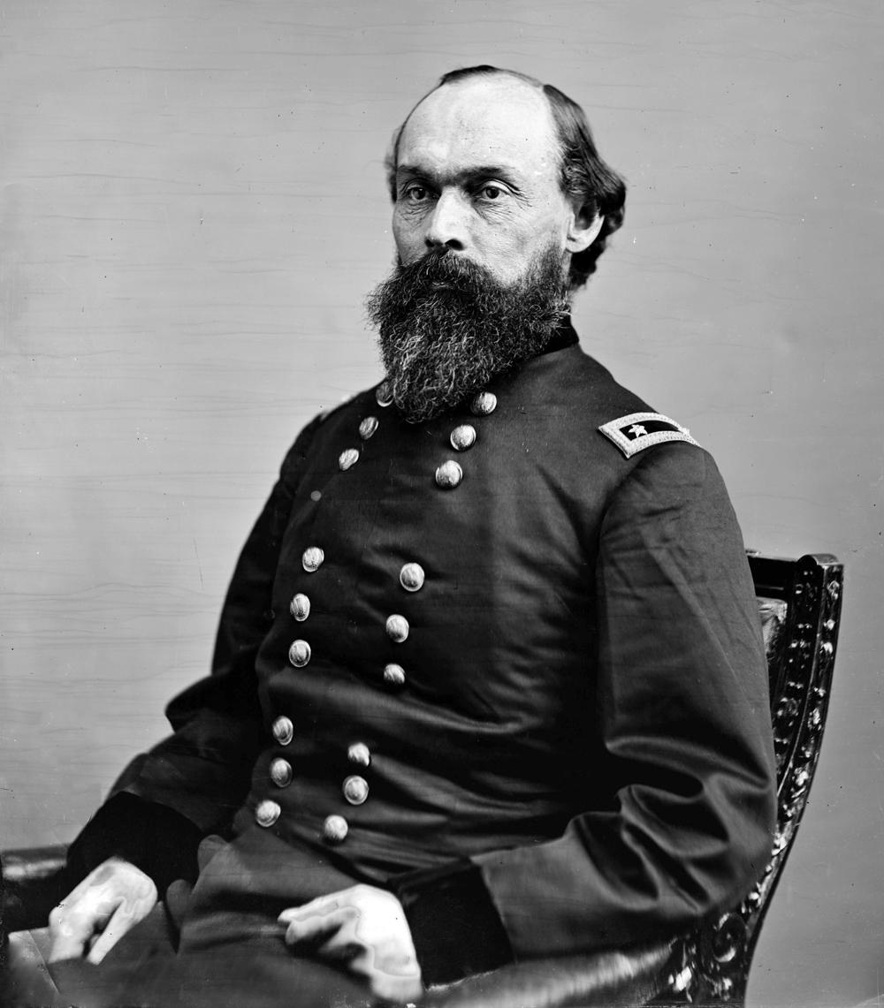
Major General Gordon Granger, 1821-1876
Commander, Department of Texas
General Order No. 3, June 19, 1865
The people are informed that in accordance with a Proclamation from the Executive of the United States, all slaves are free. This involves an absolute equality of personal rights and rights of property, between former masters and slaves, and the connection heretofore existing between them, become that between employer and hired labor.
The freed are advised to remain at their present homes, and work for wages. They are informed that they will not be allowed to collect at military posts; and that they will not be supported in idleness either there or elsewhere.

Slide 14
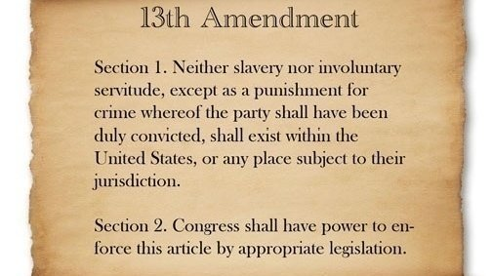
13th Amendment to the Constitution
Proposed January 31, 1865

Slide 15
Ratification of the 13th Amendment
Required: ¾ of the then 36 states (or 27 states)
The amendment was fully ratified Dec. 6, 1865.
Interesting details:
Border states Missouri and Maryland ratified in 1865,
BUT
this amendment was specifically rejected by :
Delaware on Feb 8, 1865 (ratified 1901);
Kentucky on Feb 24, 1865 (ratified 1976);
New Jersey on Mar 16, 1865 (ratified 1866);
Mississippi on Dec 4, 1865 (ratified 2012).

Slide 16
Lingering effects - into the 21st century - of the exception to the 13th amendment
(2 min silent reflection)

Slide 17
Lingering effects of the exception to the 13th Amendment
Messaging and practices: you are less-than
(2 min reading in silence )
Reconstruction Era to present (Slave Patrols, KKK, Police)
Jim Crow Laws (minstrel shows; black face; lynching; failure to pass anti-lynching laws)
Convict Leasing System (free labor for corporations, ex: railways,
mines, plantations, prisons)
Segregation (housing, education, workforce, gentrification in inner cities)
Higher Education (need for HBCU’s - ex: Cheyney University 1837 until Brown v. Board of Education 1964)
Voter Suppression (intimidation, Grandfather clauses, literacy tests)
GI Bill benefits (many Black veterans were denied)
Discrimination in housing(ownership and redlining in mortgage lending)
Prison Industrial Complex (School-to-Prison pipeline; privatization of prisons)
US Justice System (injustices: War on Drugs; stop and frisk; death row )
Reparations (debate and proposals; no legislation)

Slide 18
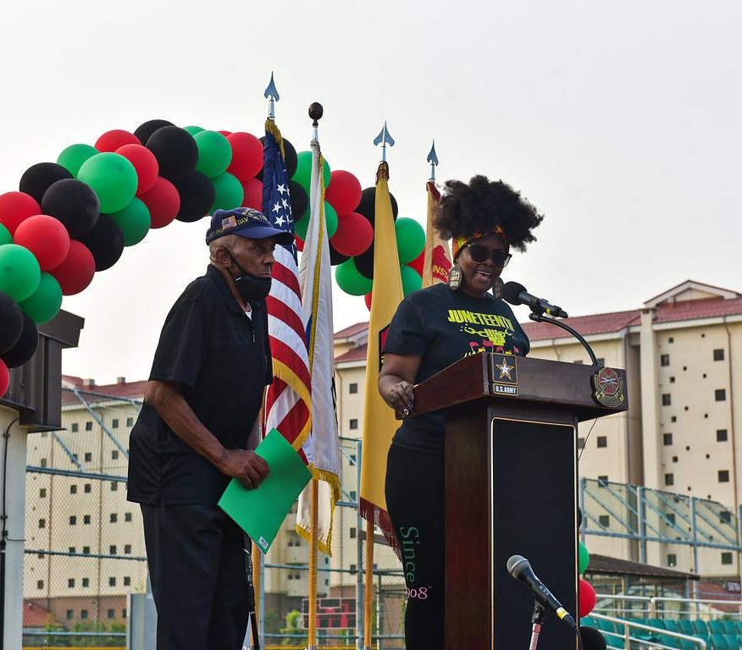
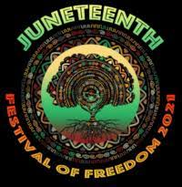
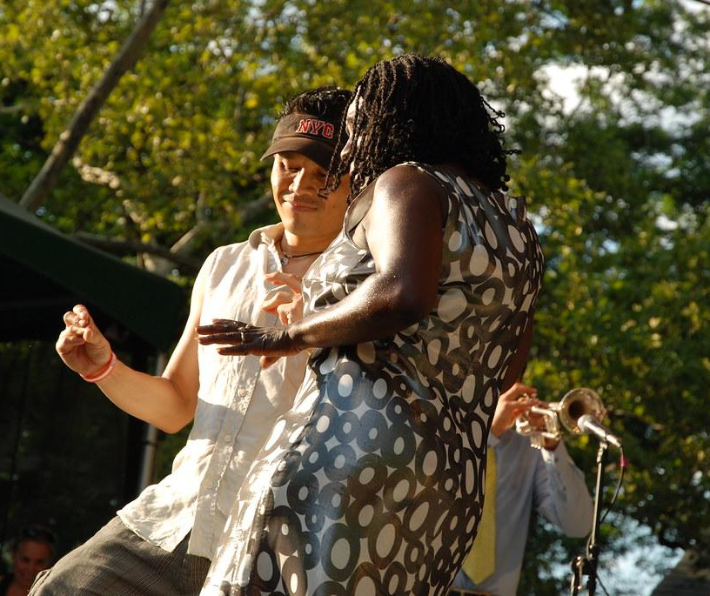
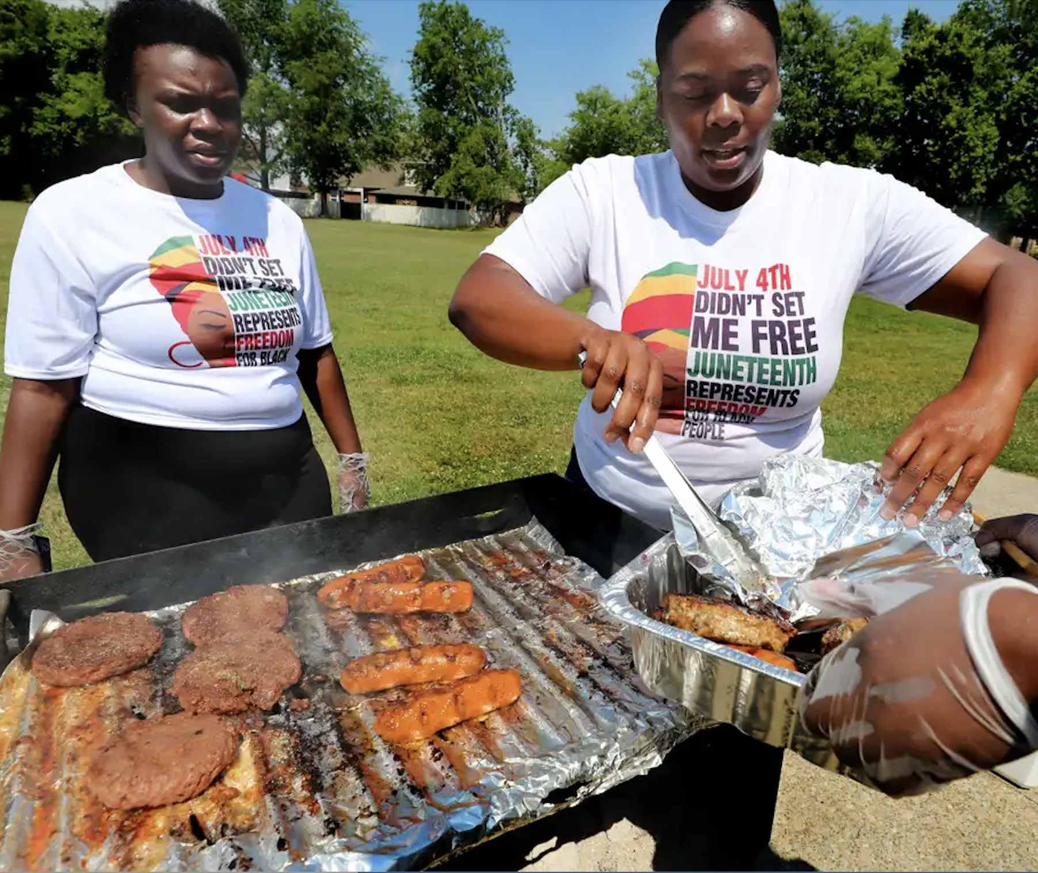
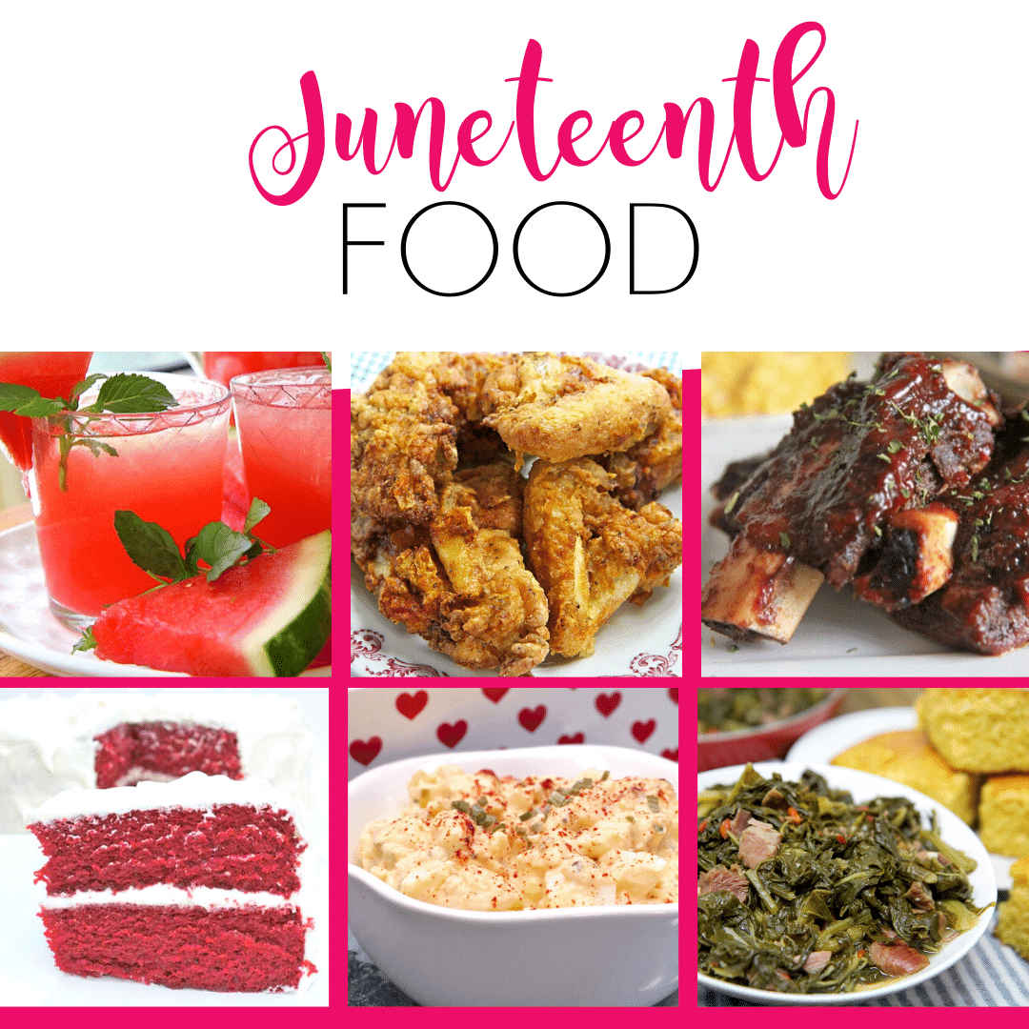
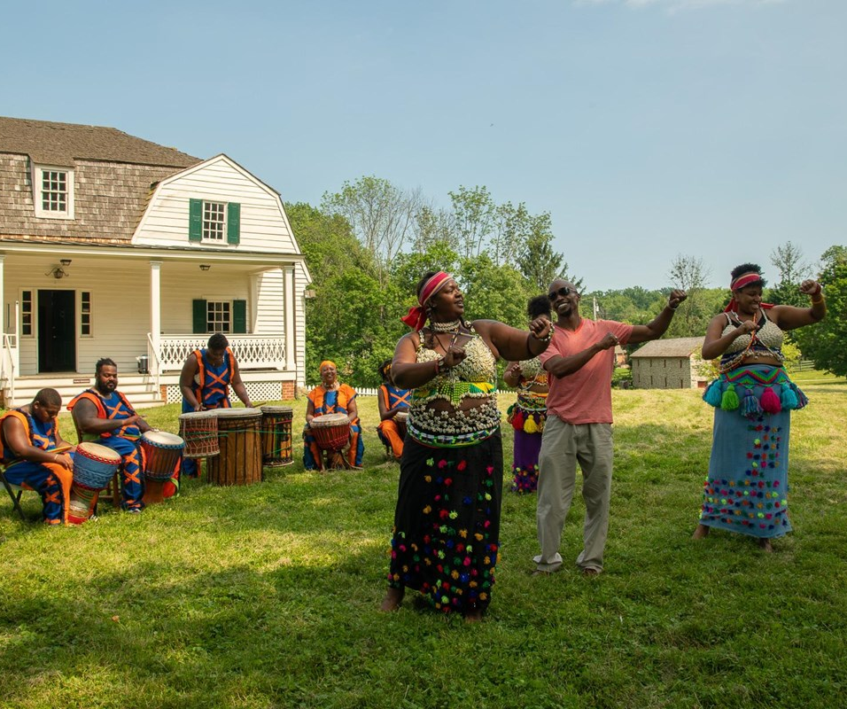
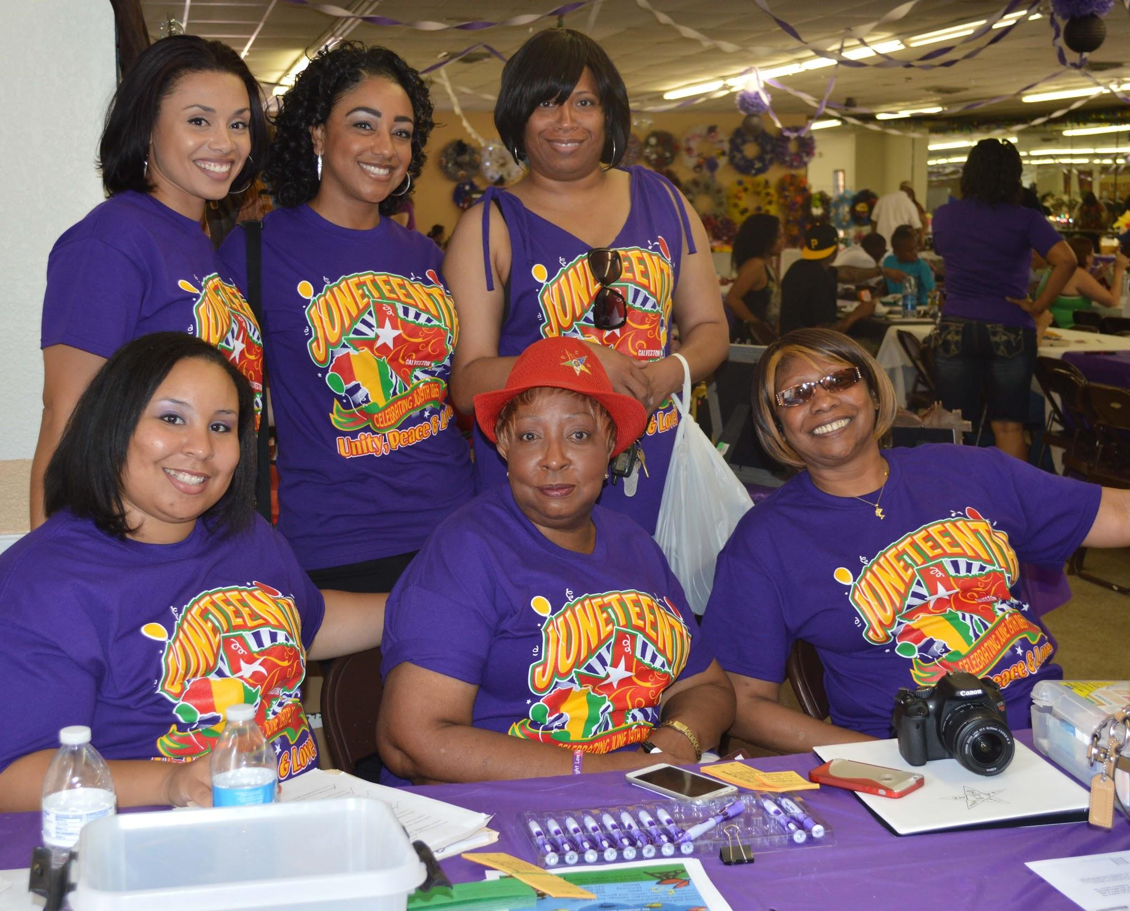
Celebration
(8 min)

Slide 19
TRADITIONS

Slide 20
How have descendants of enslaved people celebrated Juneteenth over the years?
First celebration in Texas: Jubilee Day (June 1866)
Family gatherings; prayer
Community gatherings (block/park parties)
Cookouts/BBQs
Dancing
Education (speeches, lectures, reading)
Poetry (recitations)
Storytelling (family experiences)
Film viewing

Slide 21
MUSIC

Slide 22
Spirituals/Gospels
Themes:
Faith in God
Fatigue from labor
Lamentations: Going Home
Freedom
Songs of enslaved Africans
“Swing Low, Sweet Chariot”
“Nobody knows the trouble I seen”
“Wade in the Water” Harriot Tubman
“Lift Every Voice and Sing” (the Negro National Anthem)
“This Little Light of Mine”
Civil Rights songs
“Strange Fruit” (Billie Holliday) 1939
“A Change is Gonna Come” (Sam Cooke) 1964
“We shall Overcome” 1901 (MLK, Jr Sermon March, 1965)

Slide 23
FOODS

Slide 24
African-American foods
Foods enslaved people were permitted to eat
Stigma and stereotypes attached to soul food
Thomas Jefferson - Monticello Macaroni
Lingering Dietary concerns

Slide 25
WMM’s Juneteenth cookout
Wednesday, June 15
Please join us at the Lake
6-8pm
Fried Chicken
Macaroni and Cheese
Macaroni salad
Potato salad
Vegetarian Baked Beans
Cornbread
Hotdogs/Hamburgers
Lemonade
Peach cobbler
Vanilla ice cream
Watermelon

Slide 26
QUERIES
(15min)

Slide 27
Groundrules for participating in the queries
Please speak as you are led out of the silence
Please try to limit your remarks to one minute (we will display the hourglass symbol as a timer)
Please do not speak a second time until others have had an opportunity to share a response

Slide 28
QUERIES
In your opinion, should all Americans celebrate Juneteenth?
Why do you believe the Westtown Meeting for Worship has decided to celebrate Juneteenth?
In what ways will Westtown Monthly Meeting’s annual celebration of Juneteenth help with our DEI goals?
(15 min)

Slide 29
Recap (10 min)
Queries
Thank you
Share one word that reflects your experience
Moment of silence

Slide 30
Resources
HISTORY
Video. History of Juneteenth. Freedom at Last. (6 min)
Video. Why everyone should celebrate Juneteenth? (7 min)
Video. Netflix Trailer: High on the Hog (2 min)
Juneteenth Jamboree - PBS documentary (27min)
Lecture. Summary and transcript of the Emancipation Proclamation. (1863)
Lecture. Frederick Douglass’ speech (1852) What, to the slave, is the 4th of July?
Book. Just Mercy . There is also a film; the book has more detail.)
Underground Voices. Pennsylvania grassroots organization.

Slide 31
FOOD
BBQ vs cookout: article
Booker T. Washington - what slaves could eat
Boston Globe. Stigma and stereotypes of foods
Smithsonian Magazine. Macaroni & Cheese in USA
Mix news. Soul food facts.
Healthline. Health implications of eating soulfood.
QUIZ YOURSELF
Click here for a CNN quiz

Slide 32
Resources, cont’d
SONGS - spirituals and gospels
I want Jesus to walk with me
https://youtu.be/4r2SNSYo7rQ
Trouble so hard
https://youtu.be/aYbanVLseKw
This little light of mine
https://youtu.be/DRgdOwEsEzA
Is there anybody here that loves my Jesus
https://youtu.be/tk808jJa8tM
Go down Moses
https://youtu.be/vf6jBP4YXwo
Follow the Drinking gourd
https://youtu.be/kjBZEMkmwYA
I’m tired, my soul need a restin’
https://youtu.be/rhFLcrPKCvQ
I’ll be so glad when the sun goes down
https://youtu.be/C-zlSq4mWiE
Roll Jordan Roll
https://youtu.be/S7iCMNIPNf8
We Shall Overcome - Jazz tribute
https://youtu.be/x2VO2lYd7Jw
Mary don’t you weep
https://youtu.be/HKgjnY8KT3M
Billie Holiday: Strange Fruit
Rosie - Be my woman (Prison work songs 1940’S)

